Slide 1

Project Presentation
Intro of Network Science
Tools: Gephi, Python, Excel
Zhihao Wang

Slide 2
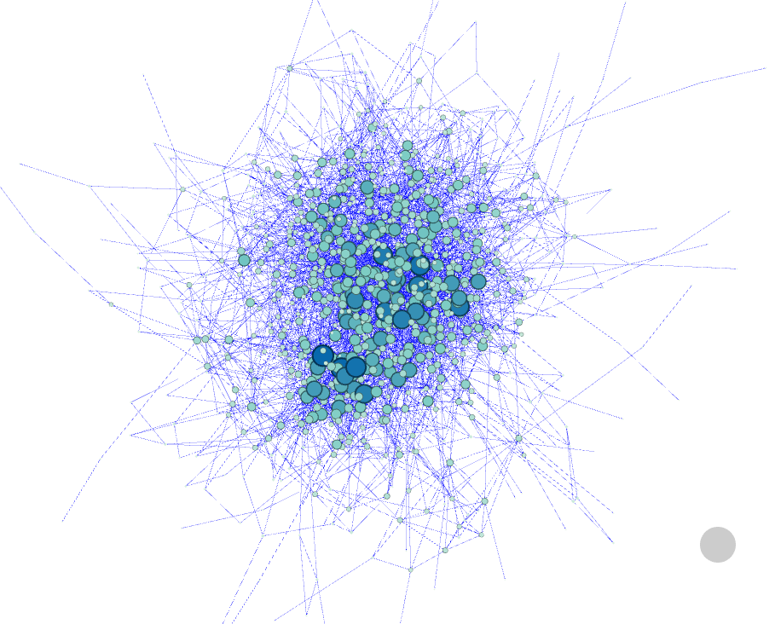

Roget's Thesaurus by Peter Mark Roget
Network with 1022 vertices and 5075 arcs

Slide 3
Roget's Thesaurus by Peter Mark Roget
Network with 1022 vertices and 5075 arcs
Average Degree: 4.966
Diameter: 14
Average Path length: 4.90

Slide 4
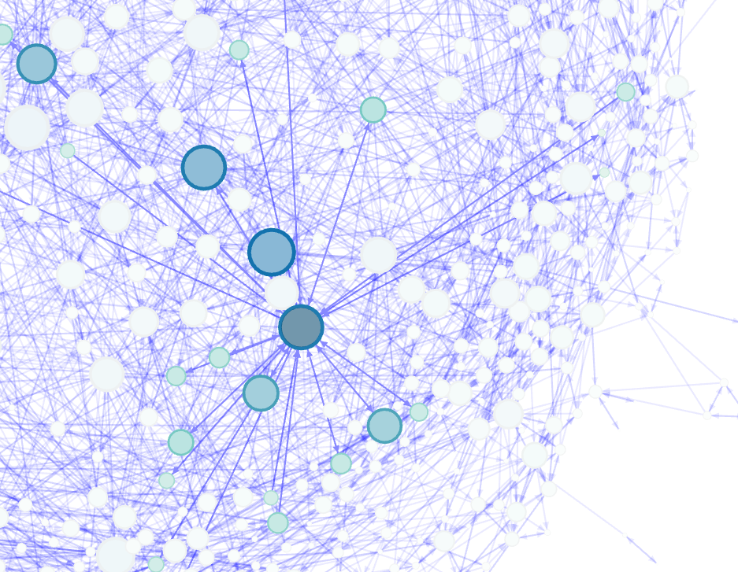
Roget's Thesaurus by Peter Mark Roget
Network with 1022 vertices and 5075 arcs
Average Degree: 4.966
Diameter: 14
Average Path length: 4.90

Slide 5
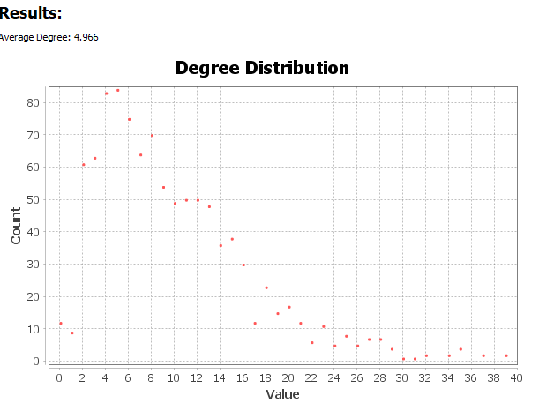
Roget's Thesaurus by Peter Mark Roget
Directed network with 1022 vertices and 5075 arcs
Average Degree: 4.966
Diameter: 14
Average Path length: 4.90
Largest degree: 39

Slide 6
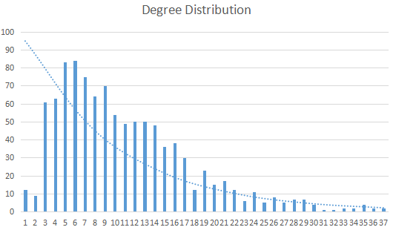
Roget's Thesaurus
Directed network with 1022 vertices and 5075 arcs
Average Degree: 4.966
Diameter: 14
Average Path length: 4.90
Largest degree: 39
Scale-free

Slide 7
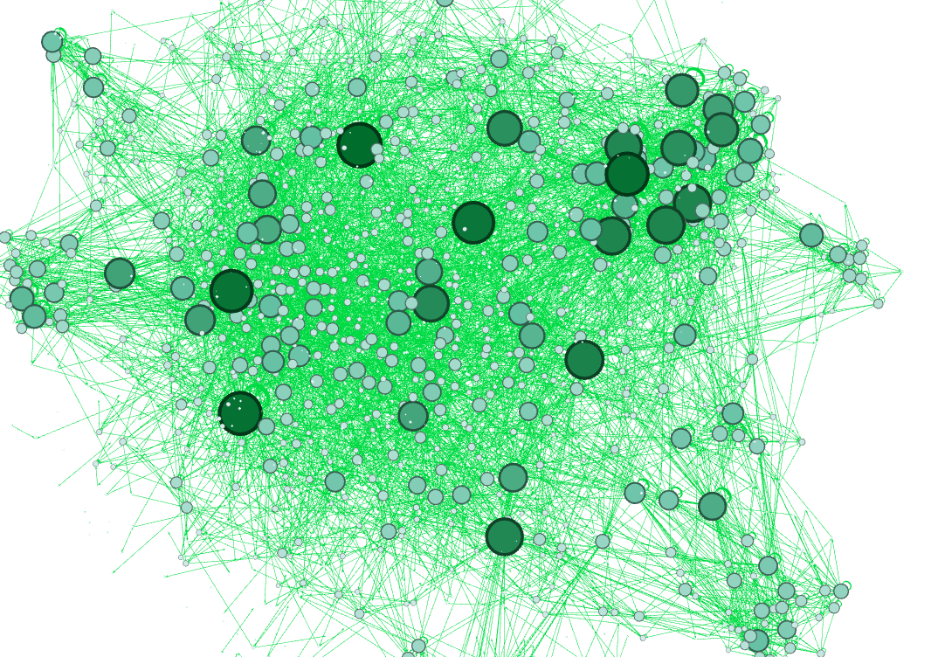
Yeast
Directed network with 2361 vertices and 7182 arcs

Slide 8
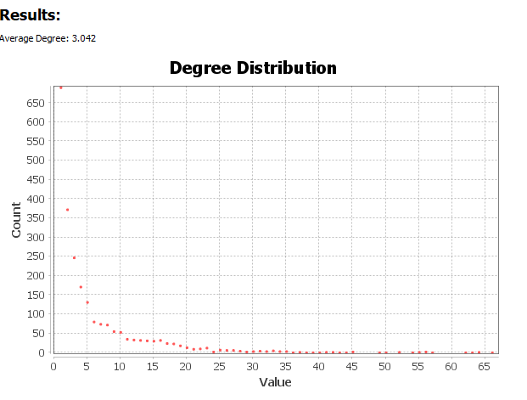
Yeast
Directed network with 2361 vertices and 7182 arcs
Average Degree: 3.042
Diameter: 16
Average Path length: 4.64
Largest degree: 66
Scale-free

Slide 9
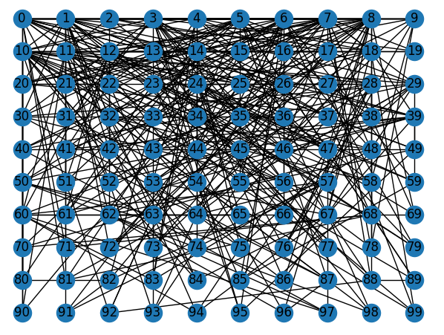
BA network made through python
Directed network with 100 vertices and an initial number of links as 4
least degree: 4
largest degree: 27

Slide 10
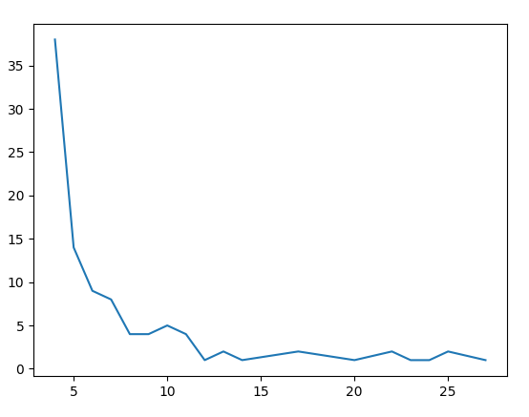
BA network made through python
Directed network with 100 vertices and an initial number of links as 4
least degree: 4
largest degree: 27
Scale-free

Slide 11
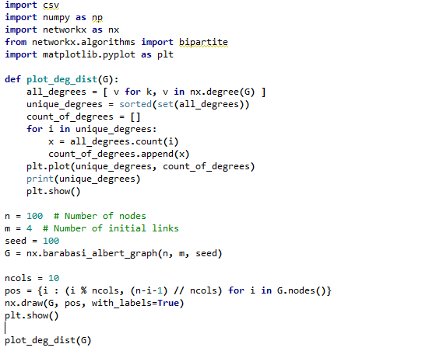

Slide 13
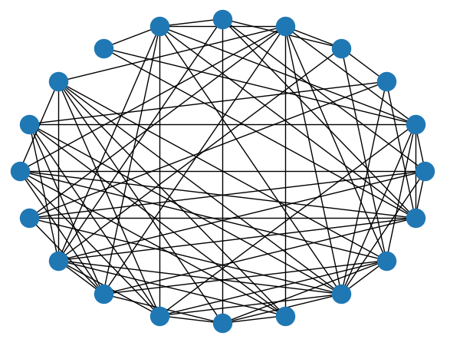
ER network made through python
Network with 20 vertices and a possibility p of 0.5
Predicted number of edges: 95.0((p * N * (N - 1)) / 2)
Actual number of edges: 78

Slide 14
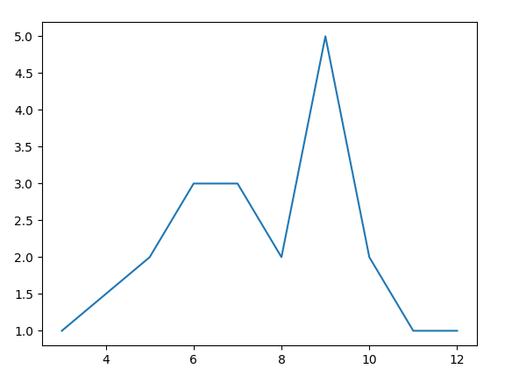
ER network made through python
Directed network with 20 vertices and a possibility p of 0.5
Predicted number of edges: 95.0((p * N * (N - 1)) / 2)
Actual number of edges: 78
(p * N * (N - 1)) / 2

